Slide 1


Introduction to HTML
Ms.Lavanya Mohan
Email : lavanya@metaverseage.ae

Slide 2
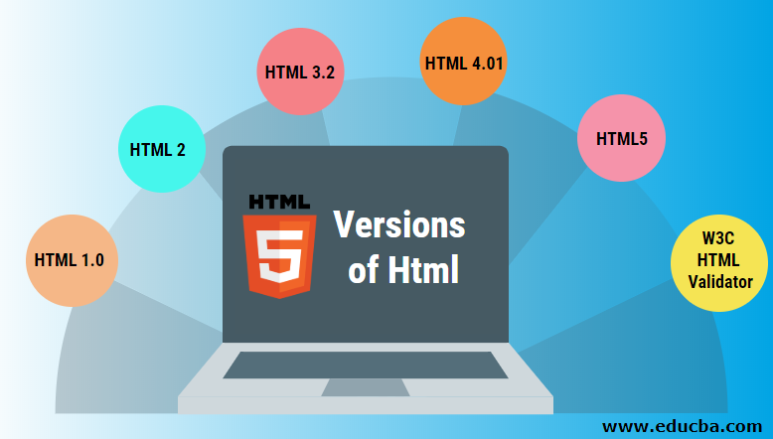
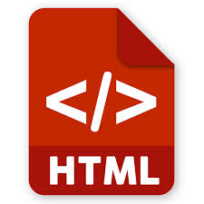
HTML (HyperText Markup Language)
HTML (HyperText Markup Language) is the code that is used to structure a web page and its content. For example, content could be structured within a set of paragraphs, a list of bulleted points, or using images and data tables

Slide 3
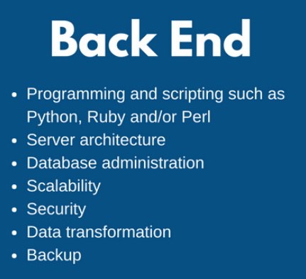
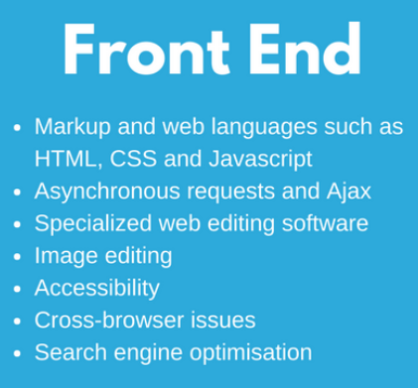


Website

Slide 4
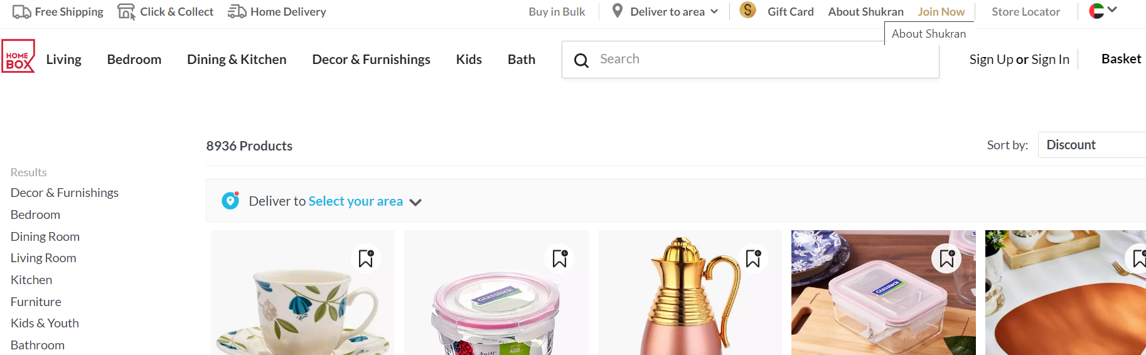
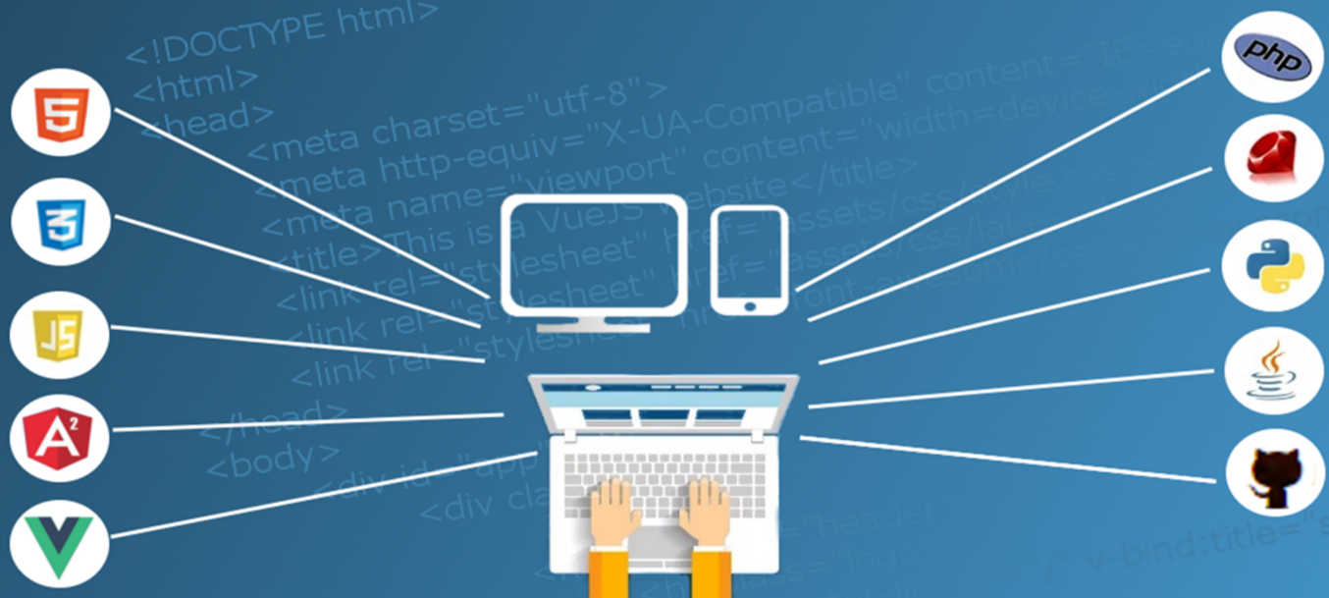
Website
Front End
Back end

Slide 5
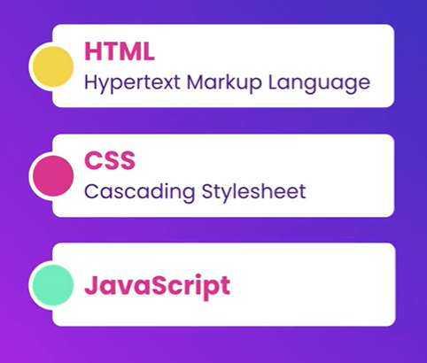
Front end web-development

Slide 6
Front end web-development

Slide 7
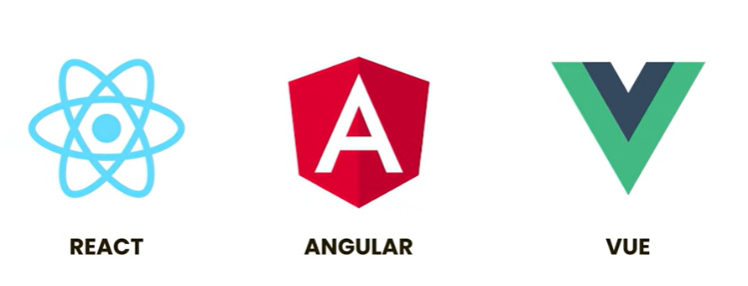

Front end web-development
Building websites often includes bunch of repetitive class
We use front end framework and libraries
Framework or library comes with lot of codes that we can reuse in our websites.
These are the library/framework which helps us build
our applications faster
React is a powerful library and is very popular for
beginners
Version Control system like GIT is used the to keep track of projects while working collaboratively.

Slide 8
HTML
HTML (Hypertext Markup Language) is used to create document on the World Wide Web. It is simply a collection of certain key words called ‘Tags’ that are helpful in writing the document to be displayed using a browser on Internet.
It is a platform independent language that can be used on any platform such as Windows, Linux, Macintosh, and so on. To display a document in web it is essential to mark-up the different elements ( headings, paragraphs, tables etc. ) of the document with the HTML tags. To view a mark-up document user has to open the document in a browser. A browser understands and interpret the HTML tags, identifies the structure of the document (which part are which) and makes decision about presentation (how the parts look) of the document.
HTML also provides tags to make the document look attractive using graphics, font size and colours. User can make a link to the other document or the different section of the same document by creating Hypertext Links also known as Hyperlinks

Slide 9
Introduction to HTML
HTML is used for describing web pages.
HTML stands for Hyper Text Markup Language
HTML is not a programming language, it is a markup language
A markup language is a set of markup tags
HTML uses markup tags to describe web pages

Slide 10
Introduction to HTML
Web Browser options
Google Chrome
Mozilla Firefox
Internet Explorer
Safari
Edge
……
Text Editor options
Visual Code Studio
Sublime Text
Atom.io
Brackets
Notepad ++
…….
CHOOSE AND DOWNLOAD YOUR EDITOR

Slide 11
Create your First HTML File
Creating a html file does not need a server
Files will have a .html extension
The file will run any Web Browser (Google Chrome, Mozilla Firefox, Internet Explorer, Safari, Edge etc.)
index.html is the root of any website

Slide 12
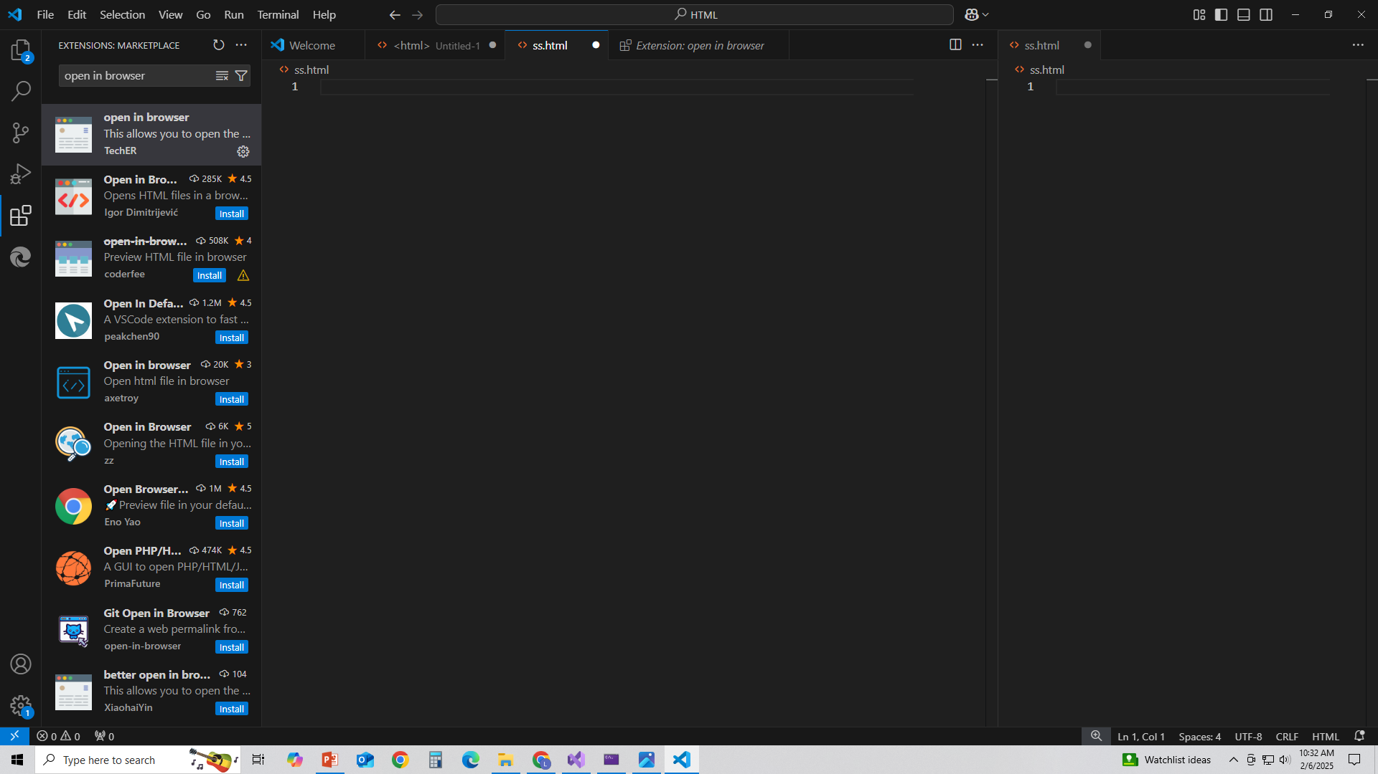
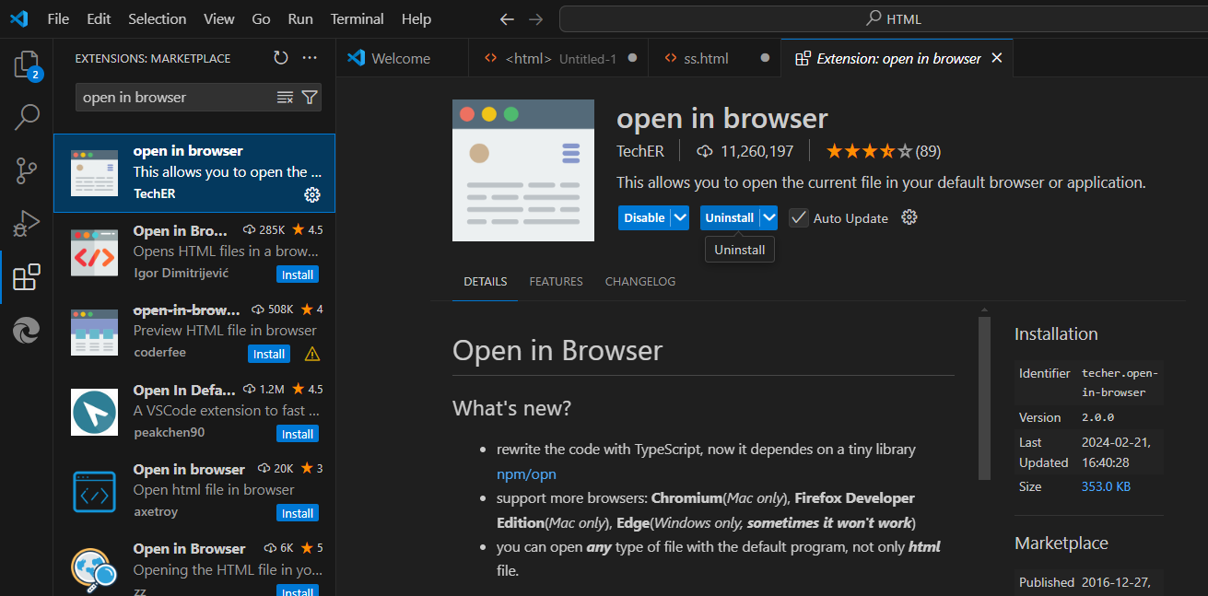
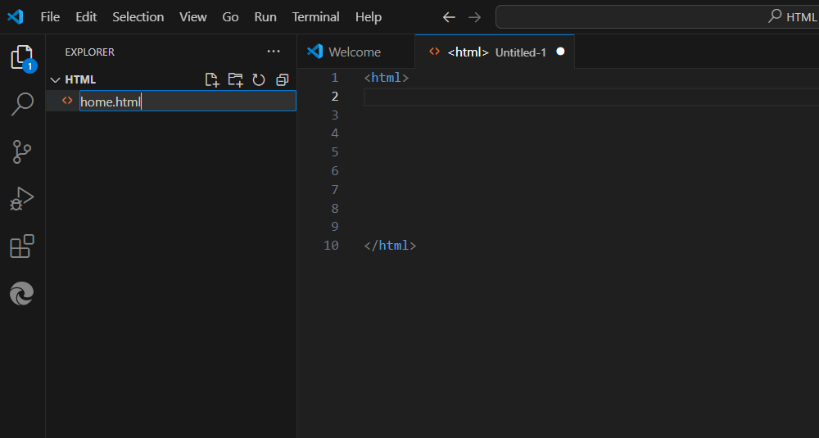
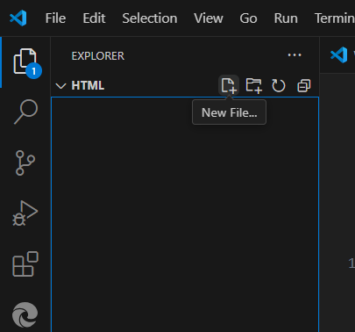
Step 1 Open your VS code editor click extension and install open in browser
Step 2 Click new folder option and create new file

Slide 13
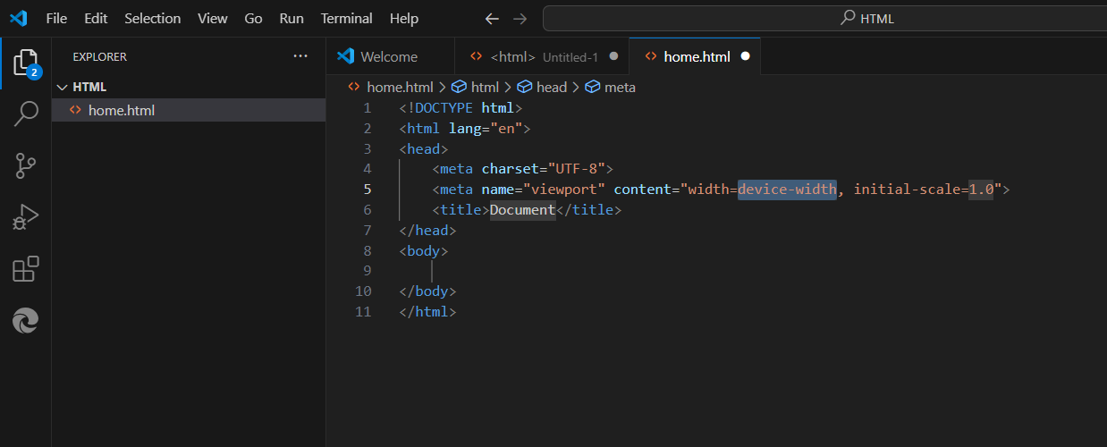
Step 3 Press exclamation symbol and click enter you will get default html structure

Slide 14

Common Terminology
Some commonly used terms in HTML are:
a)Tag: Tags are always written within angles brackets. It is a piece of text is used to identify an element so that the browser realizes how to display its contents. e.g.<HTML> tag indicates the start of an HTML document .
HTML tag are of two types
Paired Tags :A tag is said to be a paired tag if text is placed between a tag and its companion tag. In paired tag ,the first tag is referred to as opening tag and the second tag is referred to as closing tag.
Unpaired Tags: An unpaired tag does not have a companion tag .unpaired tag also known as singular or Stand-Alone tags. e.g:<br>,<hr> etc.

Slide 15
Common Terminology
b) Attribute: Attribute is the property of an tag that specified in the opening angle brackets. It supplies additional information like color, size, home font-style etc to the browser about a tag. E.g. most of the common attributes are height, color, width, src, border, align etc.
c) DTD: Document Type Definition is a collection of rules written in standard Generalized Markup Language(SGML). HTML is defined in terms of its DTDS. All the details of HTML tags, entities and related document structure are defined in the DTDS.
d) ELEMENT: Element is the component of a document’s structure such as a title, a paragraph or a list. It can include an opening and a closing tag and the contents within it.

Slide 16
HTML Tag Syntax
HTML tag is the basic building block of any webpage
Elements should be surrounded by angle brackets
<tagname>
Normally there is a start tag and end tag. End tag is usually the same but with a forward slash
<tagname>content</tagname> e.g. <h1>About us</h1>
Some tags close themselves. They do not have any content within them, specifically used for line breaking.
<br/>

Slide 17
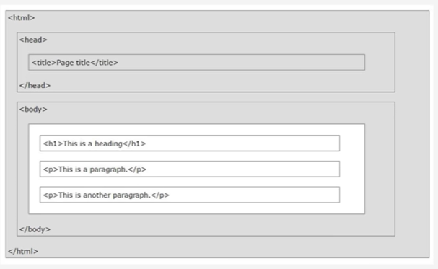
HTML page structure
We have a start and end tag
We have head area
We have body area
Head area contains information/description about the webpage
Things in the body area will be displayed in the browser

Slide 18
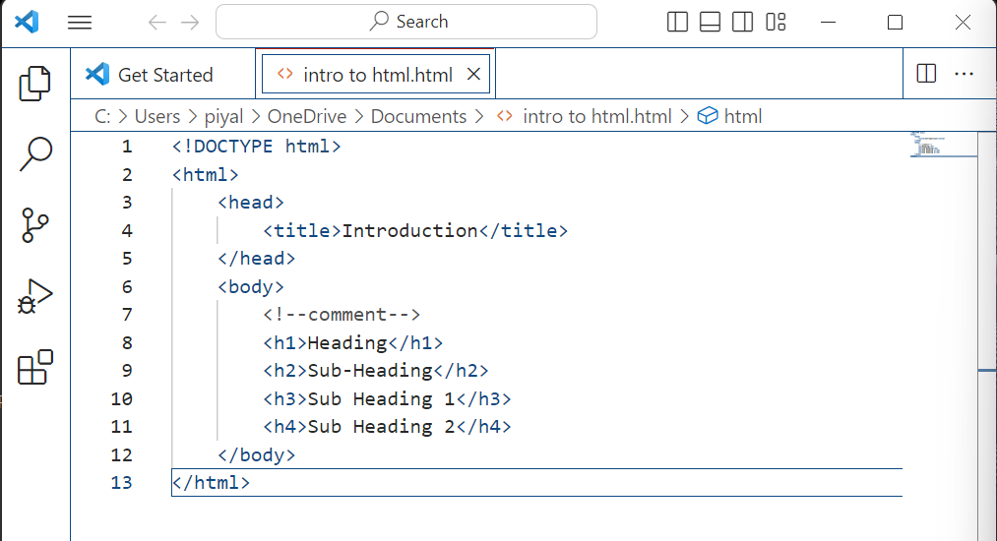

Slide 19
What does <!DOCTYPE html> mean?
<!DOCTYPE>: This stands for "Document Type Declaration" (DTD). It tells the browser what kind of document to expect and how to render it. It ensures the browser knows whether the page is HTML, XHTML, or other formats, which affects how the document is processed and displayed.
html: This indicates that the document is written in HTML5. HTML5 is the latest version of HTML, and it simplifies web development by removing the need for more complex doctype definitions that were required in older versions of HTML (like HTML 4.01 or XHTML).

Slide 20
Why is <!DOCTYPE html> important?
Quirks Mode vs. Standards Mode: Without this declaration, browsers might switch to quirks mode, which is a compatibility mode that causes the browser to render the page in a non-standard way. By including <!DOCTYPE html>, the browser knows to render the page in standards mode, which ensures consistent behavior and layout.
HTML5 Compliance: It helps browsers correctly interpret the modern HTML5 syntax, ensuring better compatibility with the latest web standards and features.

Slide 21
<!DOCTYPE html>
<html lang="en">
<head>
<meta charset="UTF-8">
<title>My Page</title>
</head>
<body>
<h1>Hello, world!</h1>
</body>
</html>

Slide 22
The <meta charset="UTF-8"> tag in HTML is used to define the character encoding for the web page.
Breakdown of <meta charset="UTF-8">:
1.<meta>:
This is an HTML tag used to provide metadata (information) about the document. The <meta> tag typically resides inside the <head> section of an HTML document.
2. charset="UTF-8“
charset is an attribute of the <meta> tag that specifies the character encoding.
UTF-8 stands for Unicode Transformation Format (UTF) with 8-bit encoding. It is one of the most widely used character encodings on the web and supports a vast range of characters, including those from different languages, special characters, symbols, and emojis.

Slide 23
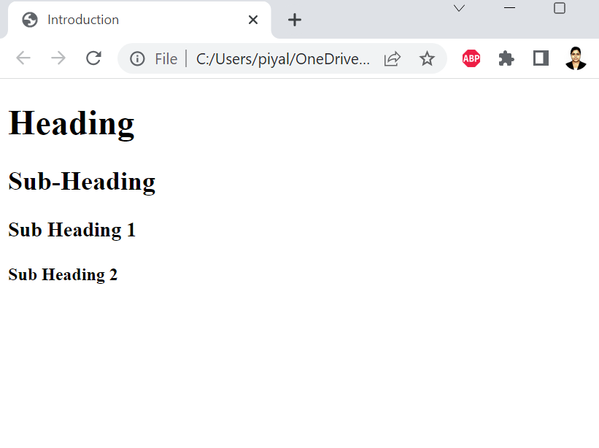

Slide 24
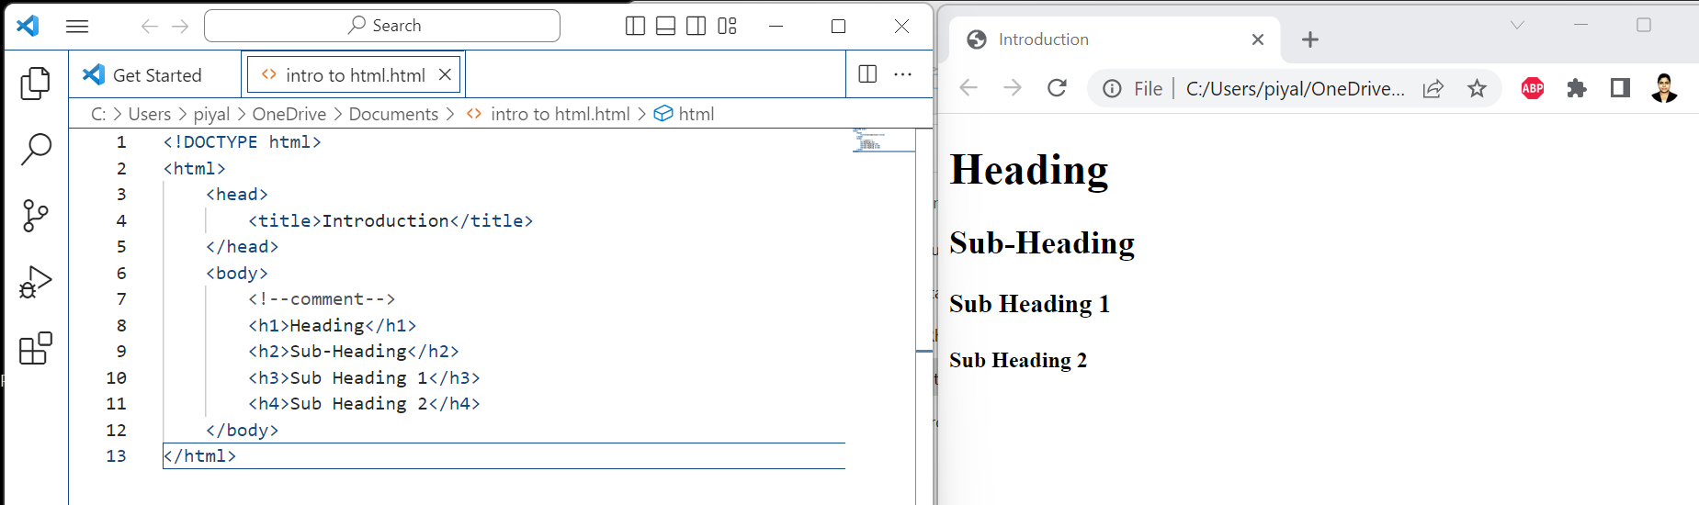

Slide 25
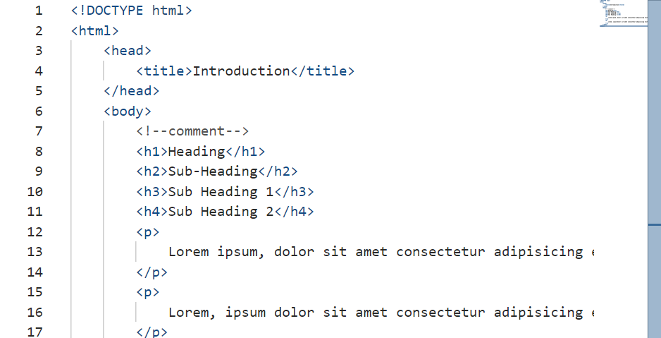

Slide 26
Exercise
Steps:
1. Open a text editor (e.g., Notepad, Sublime Text, VSCode).
2. Write Basic HTML code into your editor
3. Save the file with a .html extension (e.g., index.html).
4. Open the saved file in any web browser (e.g., Chrome, Firefox, Edge).

Slide 27
Thank You

